Slide 1
swissuniversities «P-5 Outcomes: Scientific Information Services for All»
Exhibition

Slide 2
...who we are
Notes:
Team mit Doktorierenden und Studierenden; offen für motivierte Mitglieder

Slide 3
... the concept we follow
Lively dialog with students
Skillful scholarly writing
Providing a forum for scientific dialogue among/with students.
Science and its potential
Supporting students in writing and improving their skills
Making visible smart ideas and interesting papers written by students

Slide 4
... what we do
«The purpose of cognitio is the didactic transfer of the scientific publication process to students, with the aim of introducing them to science. The primary means of achieving this, is the publication of an open access student (law) journal.»

Slide 5
Evaluation: Key Milestones 2020
Establishing an editorial office
Introducing an upload platform
Achieving a greater reach
Establishing our project across universities
Organizing a conference

Slide 6
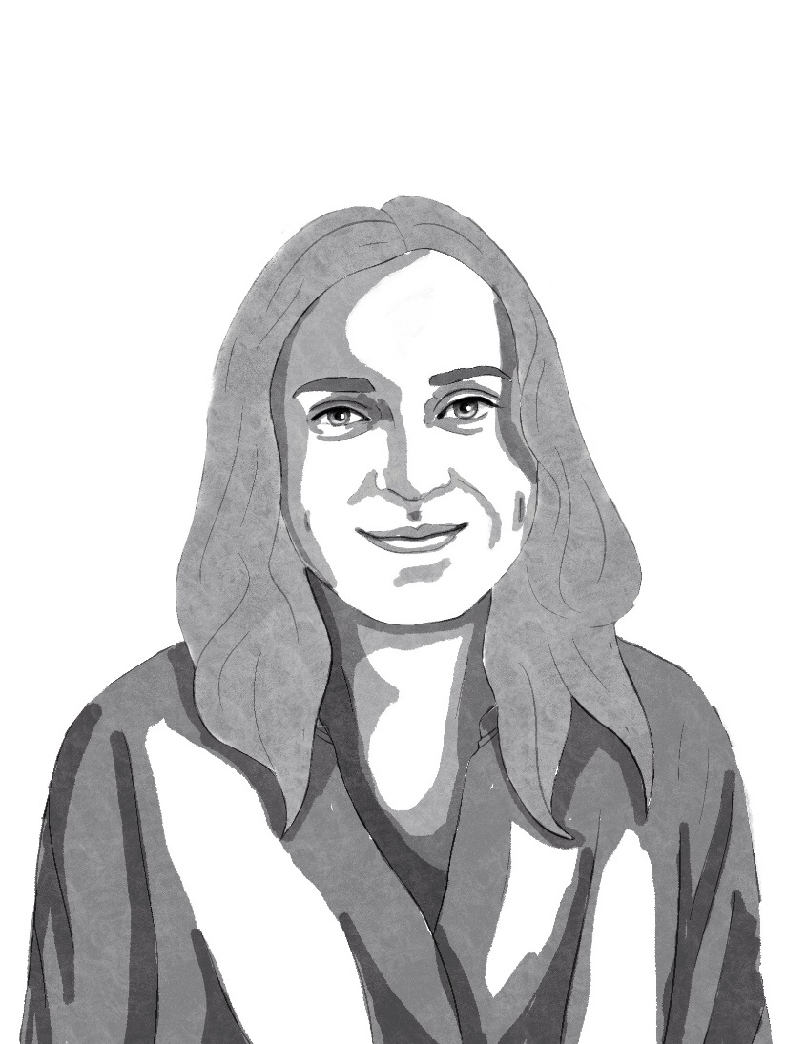
1. Establishing an editorial office
Staff
Streamlining workflows
Professionalizing communication
Regular board meetings
Anna Graf, student in social sciences
Notes:
Ca. 20 Minuten Vortrag und jeweils 15 Minuten Fragerunde.
Diskussionen mit Video

Slide 7
2.1 Introducing an upload platform
Notes:
Ca. 20 Minuten Vortrag und jeweils 15 Minuten Fragerunde.
Diskussionen mit Video

Slide 8
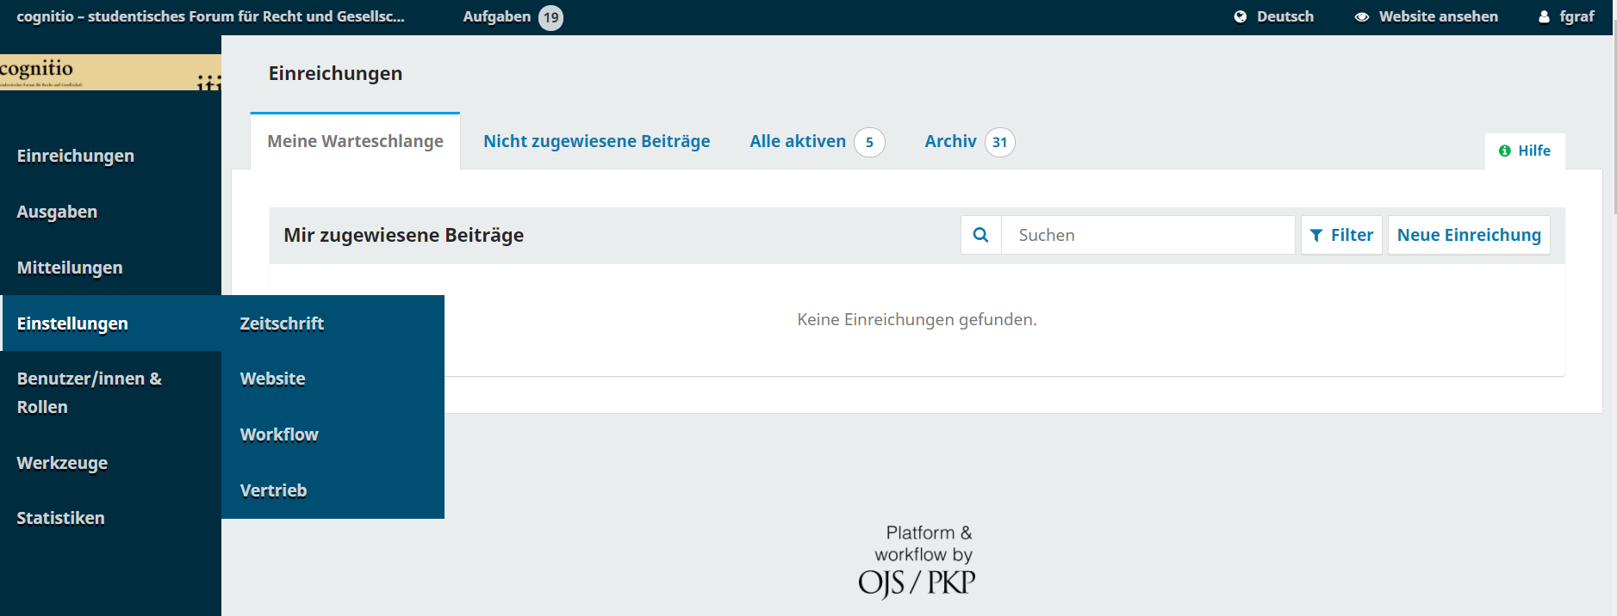
2.2 Introducing an upload platform
Notes:
Ca. 20 Minuten Vortrag und jeweils 15 Minuten Fragerunde.
Diskussionen mit Video

Slide 9
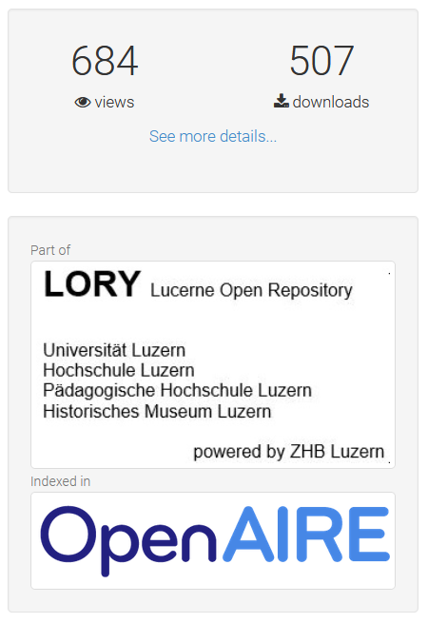
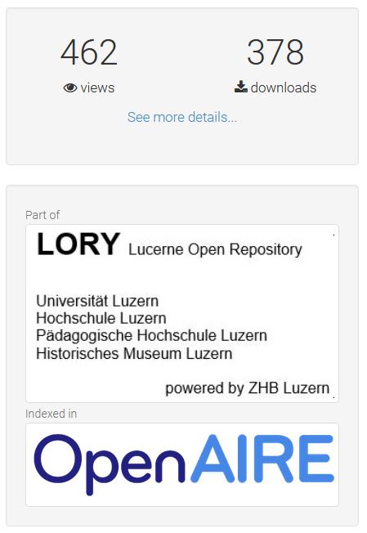
3. Achieving a greater reach
Chieh-Jan Sun
Cambridge Analytica: A Property-Based Solution
April 2020
In Englisch
Mete Erdogan
Massnahmenanordnung bei Kleptomanie?
January 2021
In German
Notes:
Ca. 20 Minuten Vortrag und jeweils 15 Minuten Fragerunde.
Diskussionen mit Video

Slide 10
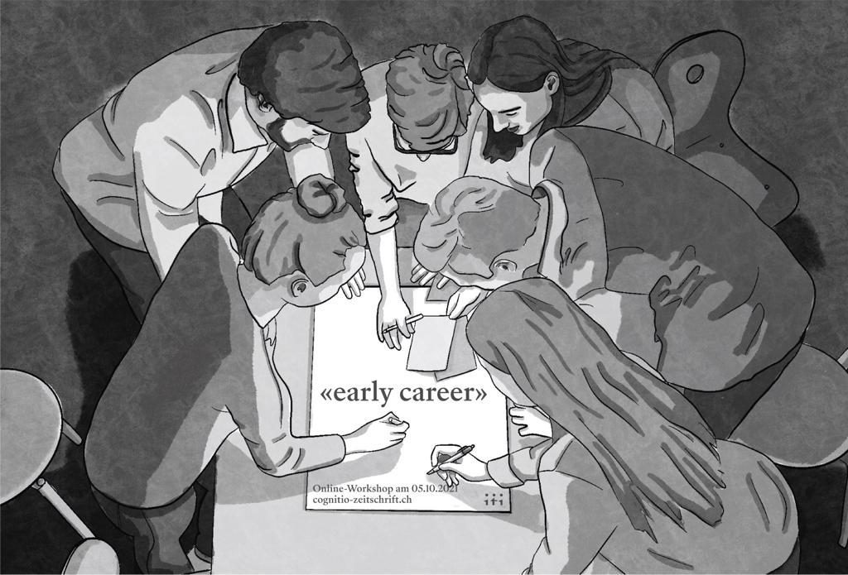
4. Establishing our project across universities
Notes:
Ca. 20 Minuten Vortrag und jeweils 15 Minuten Fragerunde.
Diskussionen mit Video

Slide 11
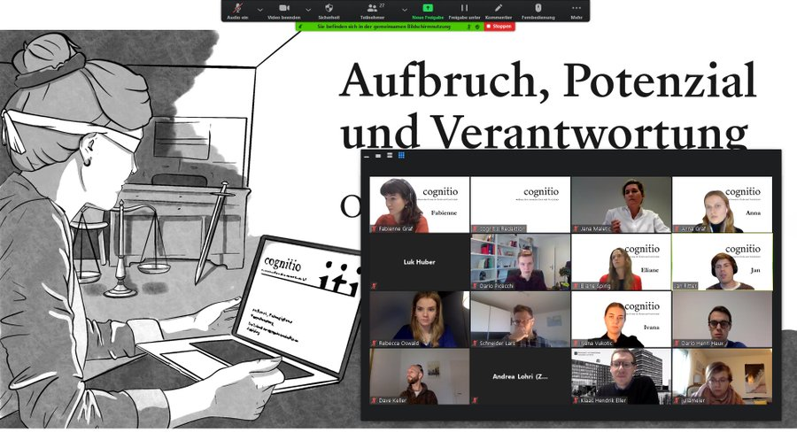
5. Organizing a conference
Notes:
Ca. 20 Minuten Vortrag und jeweils 15 Minuten Fragerunde.
Diskussionen mit Video

Slide 12
Evaluation: Key Milestones 2020
Establishing an editorial office
Introducing an upload platform
Achieving a greater reach
Further establishing our project across universities
Organizing a conference

Slide 13
Where we go from here …

Slide 14
Thank you!

