Slide 1
SWITCHengines – Your Community IaaS
Ann Harding
ann.harding@switch.ch
HECD August 2020

Slide 2
SWITCHengines
Customer tailored computing and storage performance for universities, research and teaching – further developed in the SCALE-UP project mandated by swissuniversities.
Users
Universities
Research institutions
eLearning Center
University hospitals
Spin-Offs
Services
Compute resources
Storage
Classroom/lab features
Your benefits
Your data in Switzerland
Integrated network and security
Support for academic use cases
Simple administration and billing
Created together with you

Slide 3
Different Usage Types
Education
Classroom usage during semester. Cost effective way to provide infrastructure to students
Research
Simulations, Machine Learning, Infrastructure, Storage
SNF Funding
University IT Services
Backups, Storage, Virtual Machines

Slide 4
Streamlining labs and classroom

Slide 5
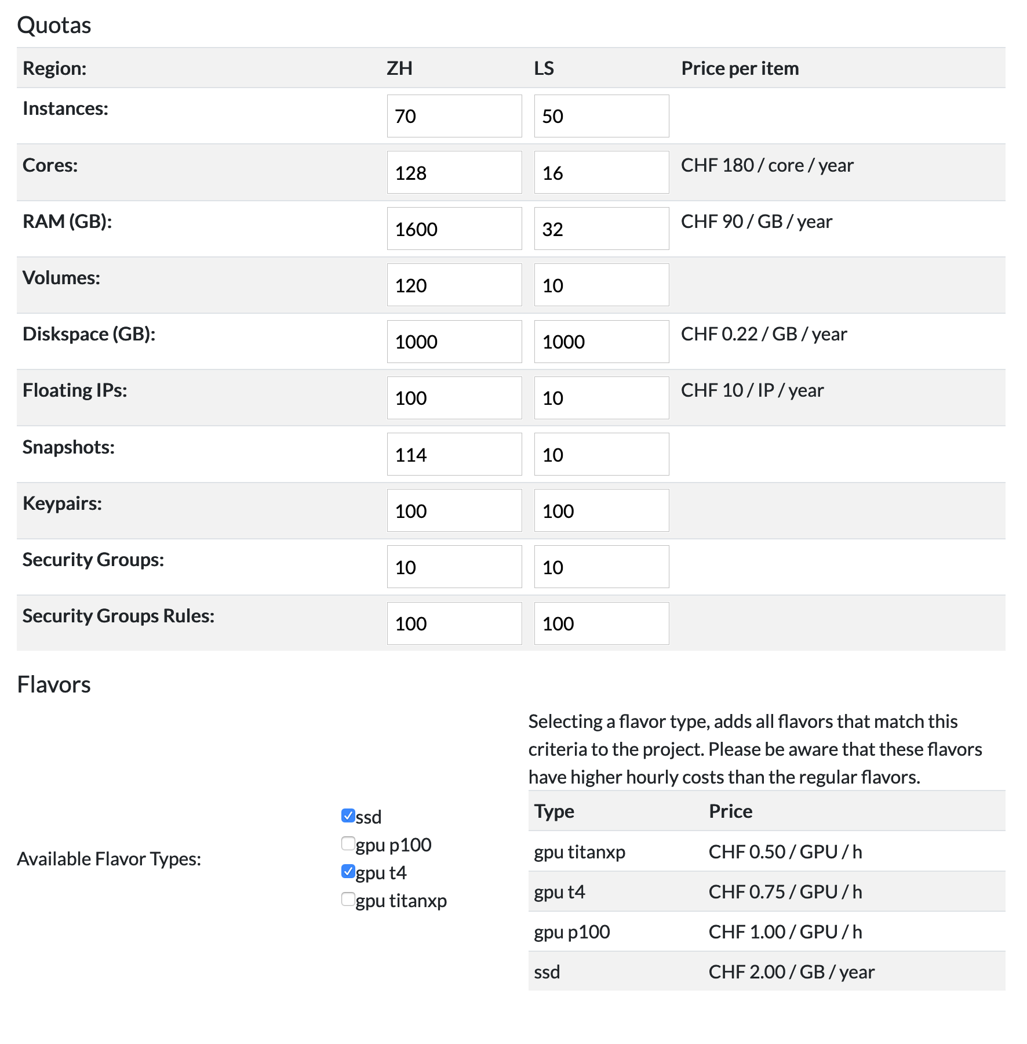
Research use cases with GPU & SSDs
3 types of NVIDIA GPUs
TitanX: Education / Tests
T4: Machine Learning / Tensor Flow
P100: Numerical Simulations
In use by SDSC

Slide 6
Usecases SWITCHengines
Virtual Machines
Simulation
High Performance
Databases
Data locally accessible
->Active Data

Slide 7
Usecases SWITCHengines
Object-Store
Cloud native data storage
Data for Simulations
Data for education
Backup of your current work
Make your data globally accessible (Private or Public)

