Slide 1
Meet the Swiss Universities of Applied Sciences and Arts

Slide 2
01 Switzerland: Facts and figures
02 Economy: Work and employment
03 Innovation/Competitiveness
04 References
05 Education: One of the world’s best systems
06 swissuniversities
07 Universities of applied sciences and arts (UAS)

Slide 3
Switzerland:
Facts and figures
01

Slide 4
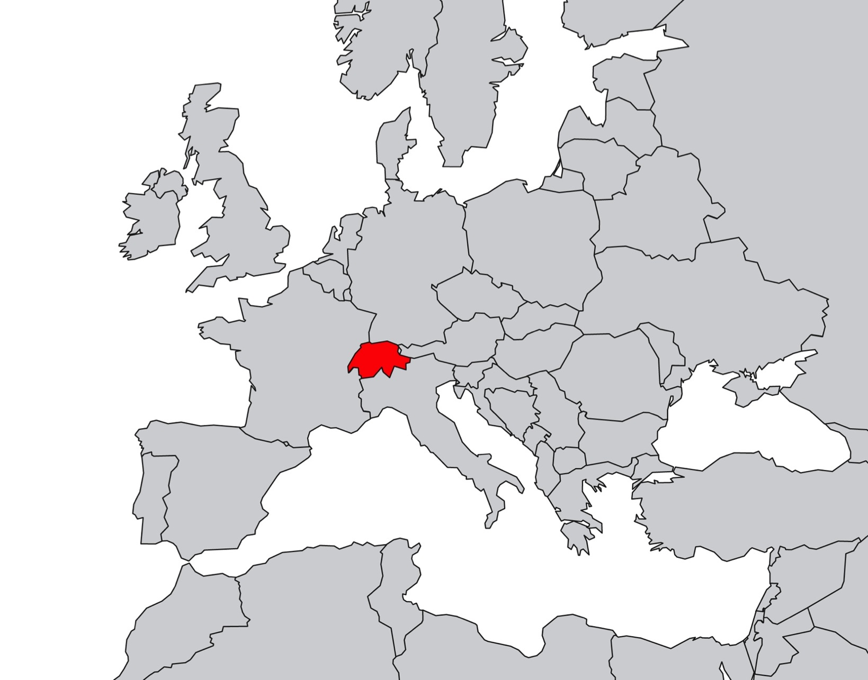

Slide 5
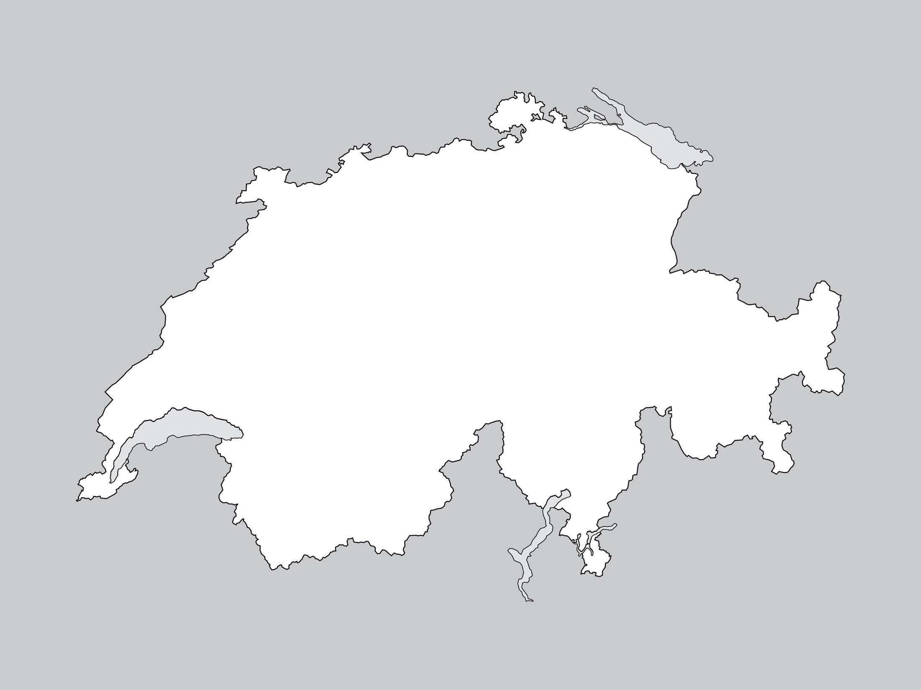
Area
^{41,285 km²}
^{or 0.025% of world’s}
^{surface area.}
Source: Federal Statistical Office, 2014

Slide 6
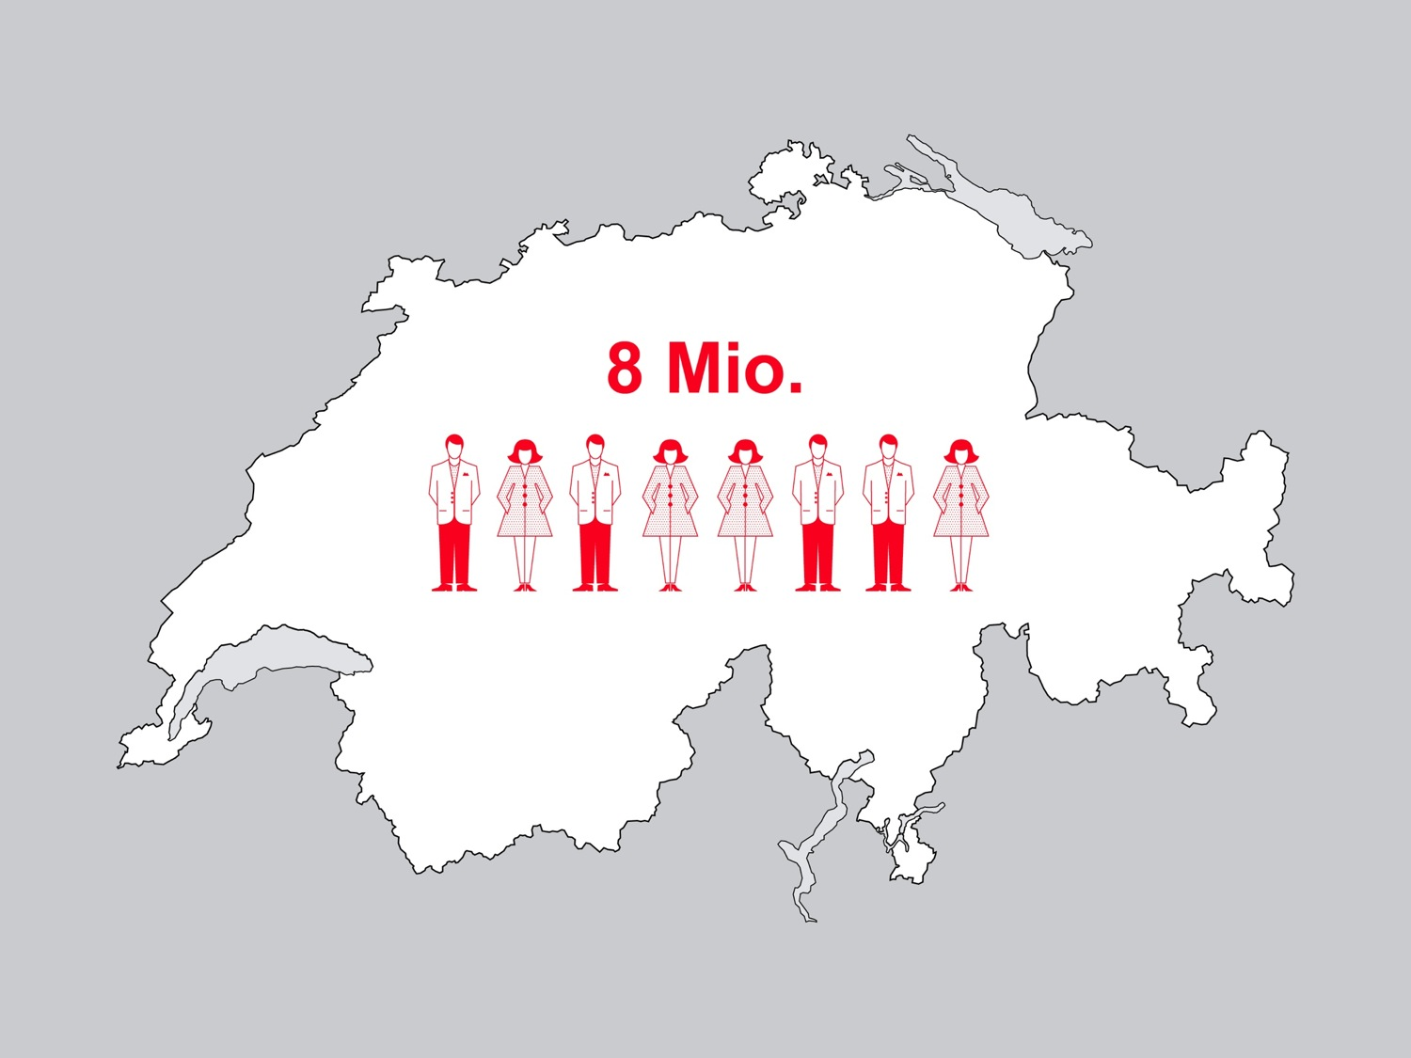
Population
23.8% resident foreigners
85% of which European
Over two-thirds
of the population live
in urban areas
Source: Federal Statistical Office, 2014

Slide 7
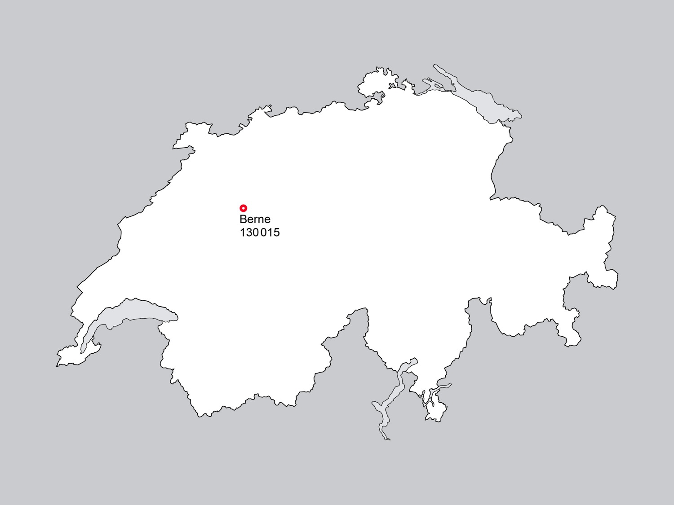
Capital
Source: Federal Statistical Office, 2014

Slide 8
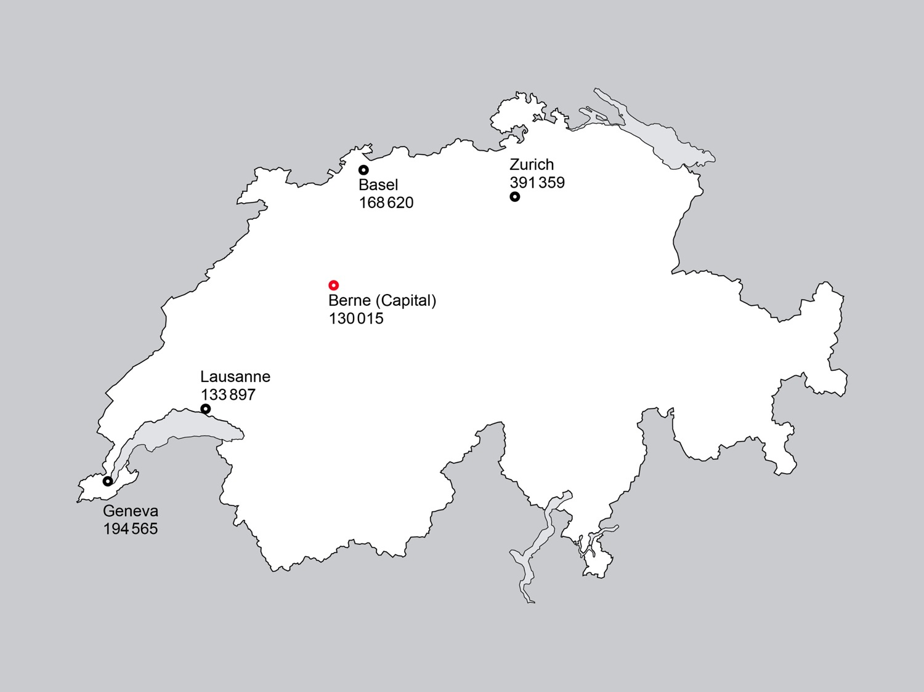
Largest cities
Source: Federal Statistical Office, 2014

Slide 9
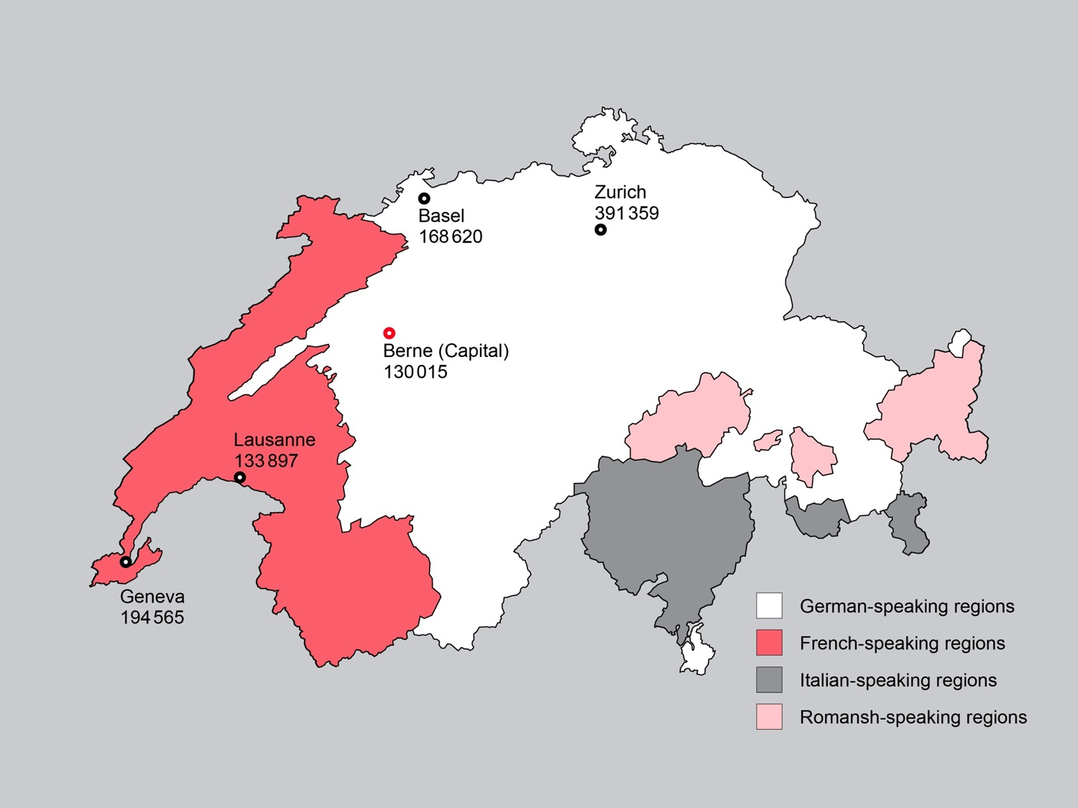
Languages
4 national languages:
German, 64%
French, 20%
Italian, 6%
Romansh, <1%
Other languages, 9%
Business:
English
Source: Federal Statistical Office, 2014

Slide 10
Economy:
Work and employment
02

Slide 11
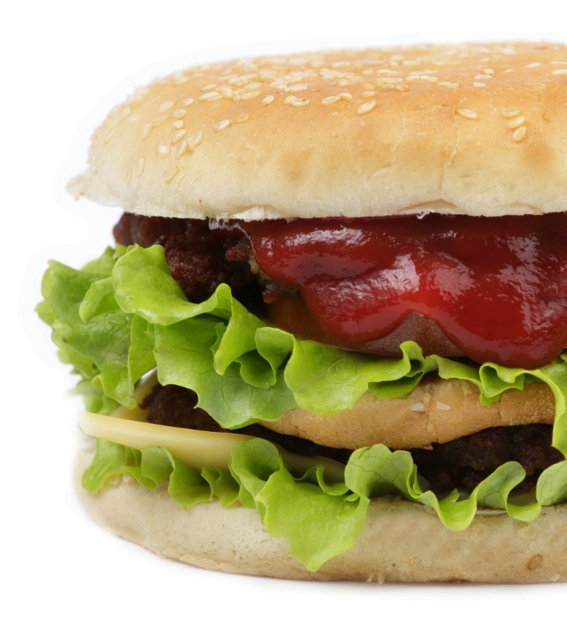
Big Mac Index 2014:
Price of 1 Big Mac in USD
Source: The Economist, 2014

Slide 12
Sectoral composition in 2014
Source: Federal Statistical Office, 2014

Slide 13

76%
of the workforce were employed
in the tertiary sector (services), …

Slide 14
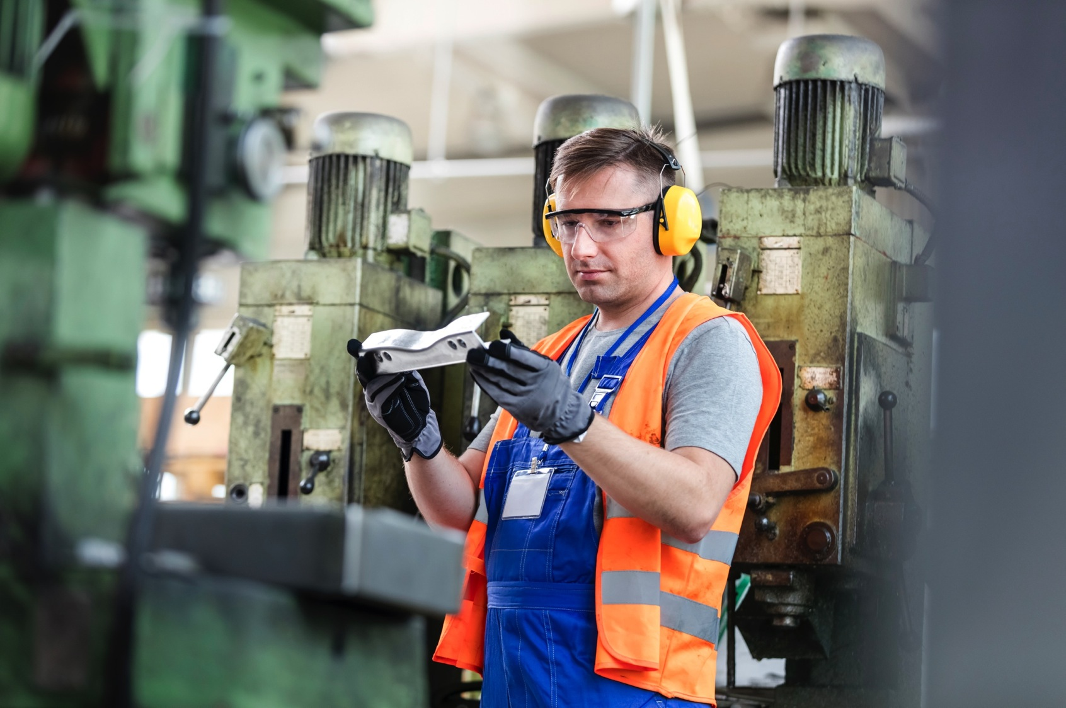
in the secondary sector (industry) and …
20.3%

Slide 15
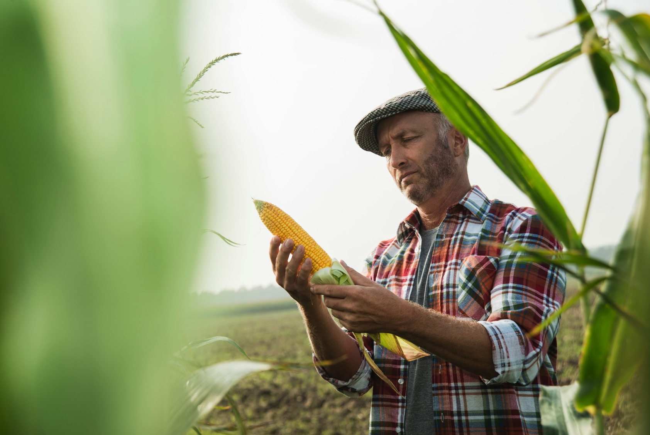
in the primary sector (farming).
3.6%

Slide 16
Innovation/Competitiveness
03

Slide 17
A history of innovation
 | Country/Economy | Score (0–100)
1. | Switzerland | 68.30
2. | United Kingdom | 62.42
3. | Sweden | 62.40
4. | Netherlands | 61.58
5. | United States of America | 60.10
6. | Finland | 59.97
7. | Singapore | 59.36
8. | Ireland | 59.13
9. | Luxembourg | 59.02
10. | Denmark | 57.70
Source: The Global Innovation Index 2015

Slide 18
Exceptional competitiveness
 | Country/Economy
1. | Switzerland
2. | Singapore
3. | United States of America
4. | Germany
5. | Netherlands
6. | Japan
7. | Hong Kong SAR
8. | Finland
9. | Sweden
10. | United Kingdom
Source: The Global Competitivness Report 2015–2016

Slide 19
References
04

Slide 20











Internationally renowned brands
Successful companies worldwide are
– recruiting our graduates for challenging jobs
– looking to us as an innovative partner for research

Slide 21
Education:
One of the world’s best systems
05

Slide 22
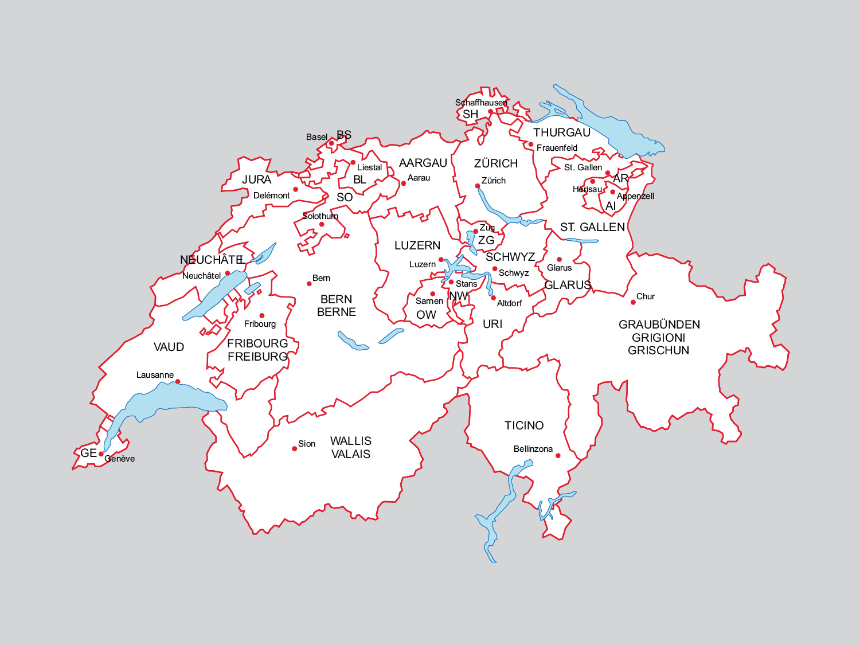
Federalist organization of Switzerland’s higher education
Source: Federal Statistical Office, 2014

Slide 23
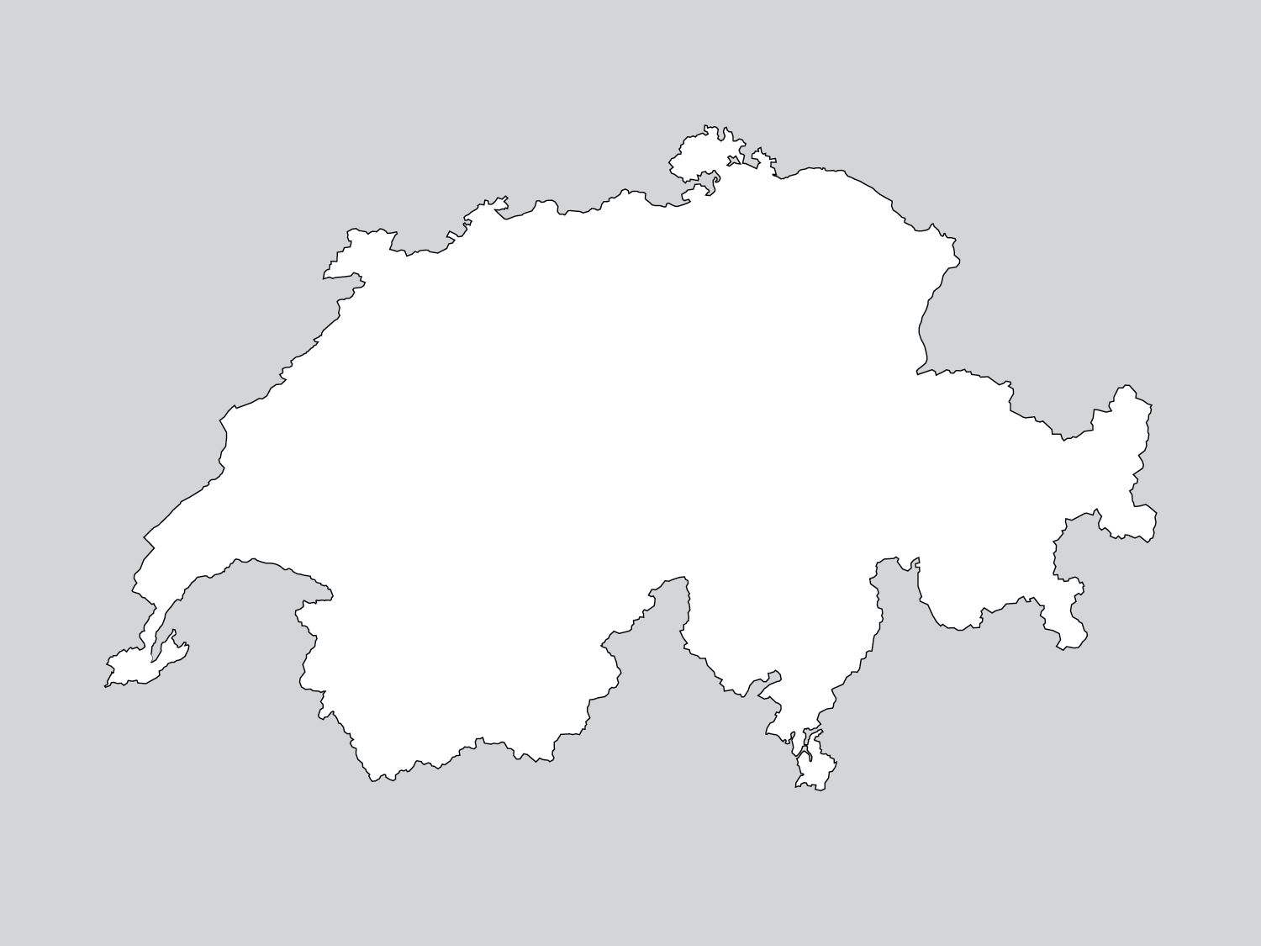
The Swiss higher education landscape in context
8
Universities of applied sciences
and arts
(30% of all students)
14
Universities of teacher education
(8% of all students)
12
Universities
(67% of all students)
Source: Federal Statistical Office, 2014
Notes:
((Allenfalls nur Sprechtext?)) According to the Swiss Federal Constitution, the Confederation and the Cantons are jointly responsible for ensuring the competitiveness and quality of Switzerland’s higher education sector.
2 federal institutes of technology
10 cantonal universities
8 universities of applied sciences
16 universities of teacher education
other tertiary A-level institutions

Slide 24
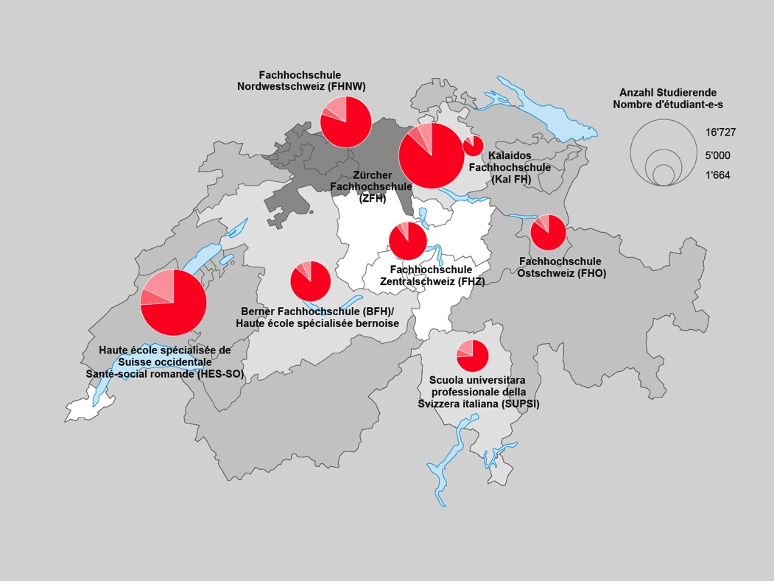
Location and size of the Swiss UAS
Number of students by origin and educational background:
Swiss
Foreigners – education in Switzerland
Foreigners – education abroad
Source: Federal Statistical Office, 2014

Slide 25
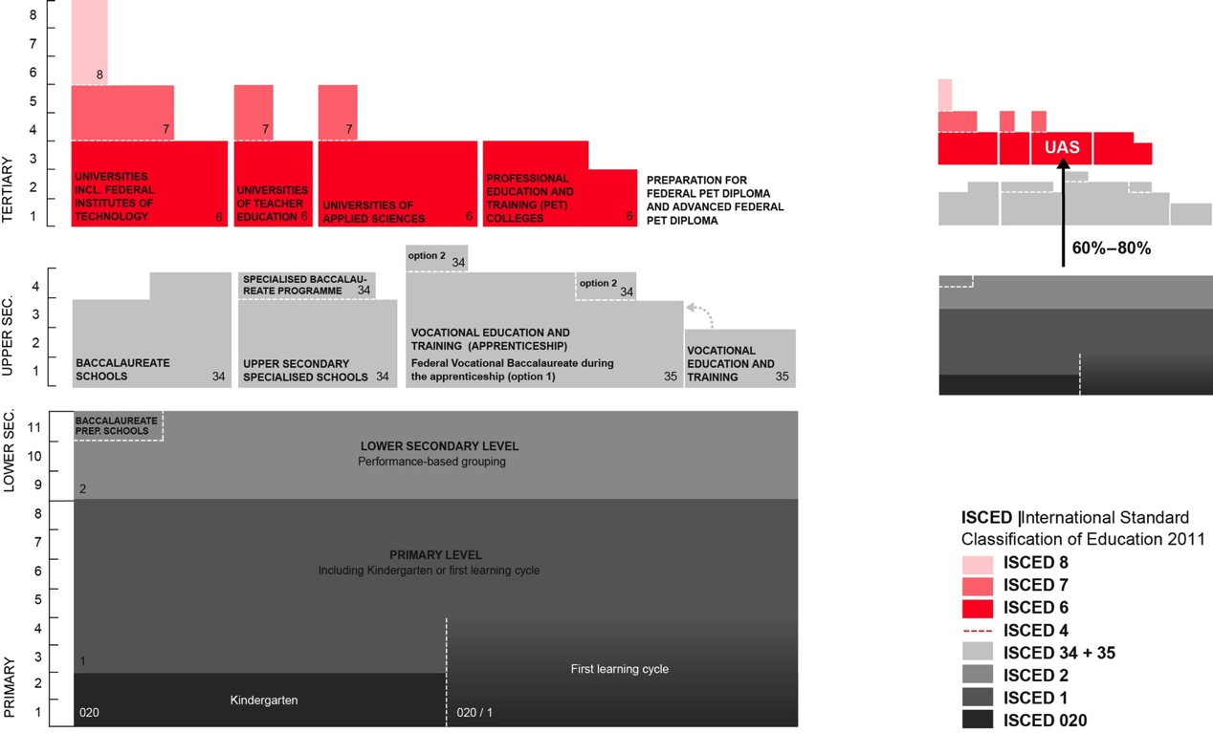
The Swiss education system
Source: EDK, 2014

Slide 26
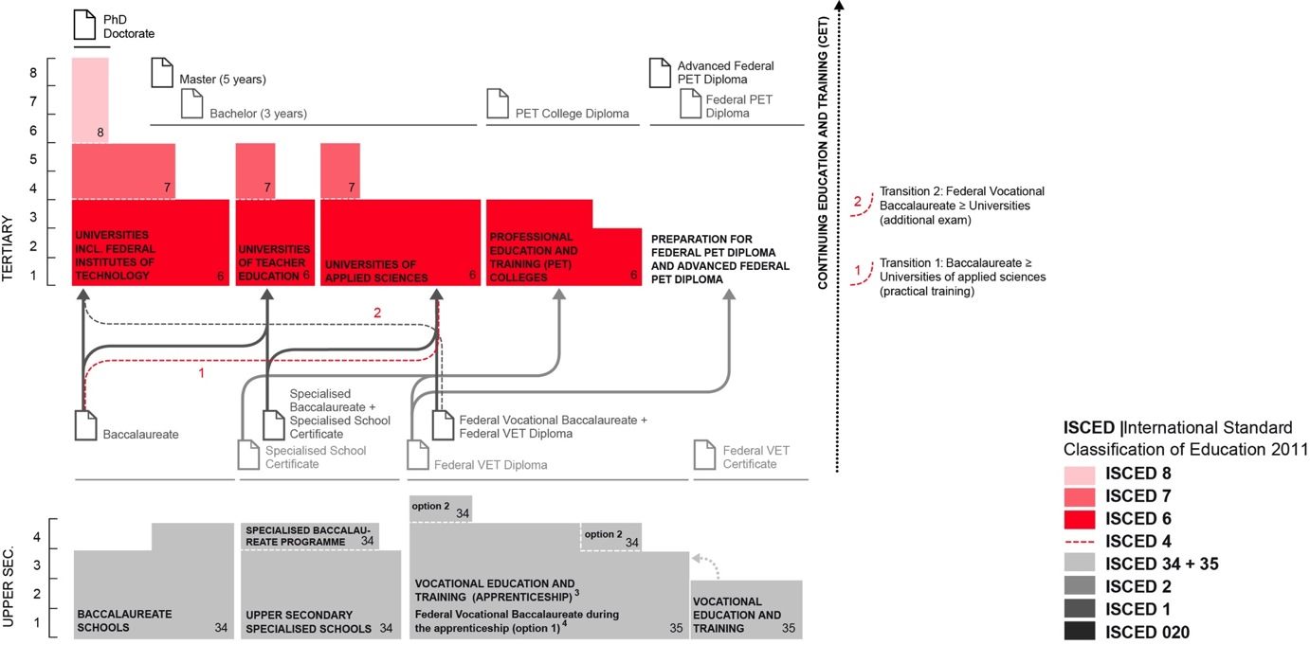
The Swiss education system
Source: EDK 2014

Slide 27
swissuniversities –
The Swiss Conference of Higher Education Institutions
06

Slide 28
swissuniversities
A joint organization for universities, universities of applied sciences and universities of teacher education
General Secretary
Chamber of Universities
Teaching & Studying
Research & Development
Higher Education Policy
International Relations
Education of Teachers
Coordination Teaching
Admission & Recognition
Medicine & Health
Coordination Research
Promotion of Young Talent
Coordination Higher Education Policy
Quality & Accreditation
Infrastructure & Development
Coordination International Relations
Euraxess
Governmental Grants
Multilateral Relations
Finances & Infrastructure
Chamber of Universities of Applied Sciences
Chamber of Universities of Teacher Education
Communication
IT & Controlling
Human Resources

Slide 29
Universities of applied sciences and arts (UAS)
07

Slide 30
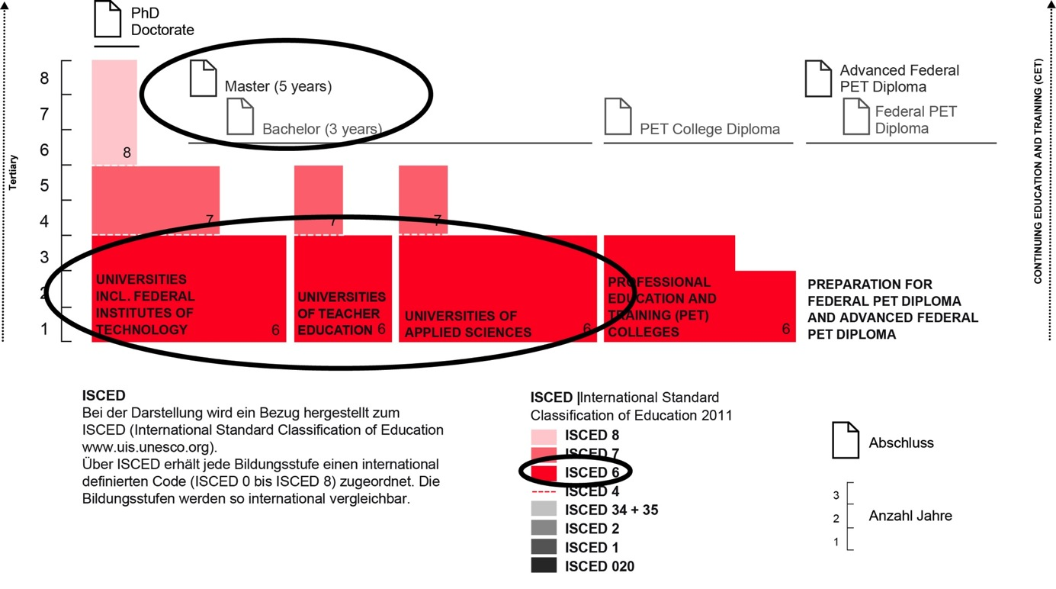
Universities of applied sciences within the higher education system
Source: EDK 2014

Slide 31
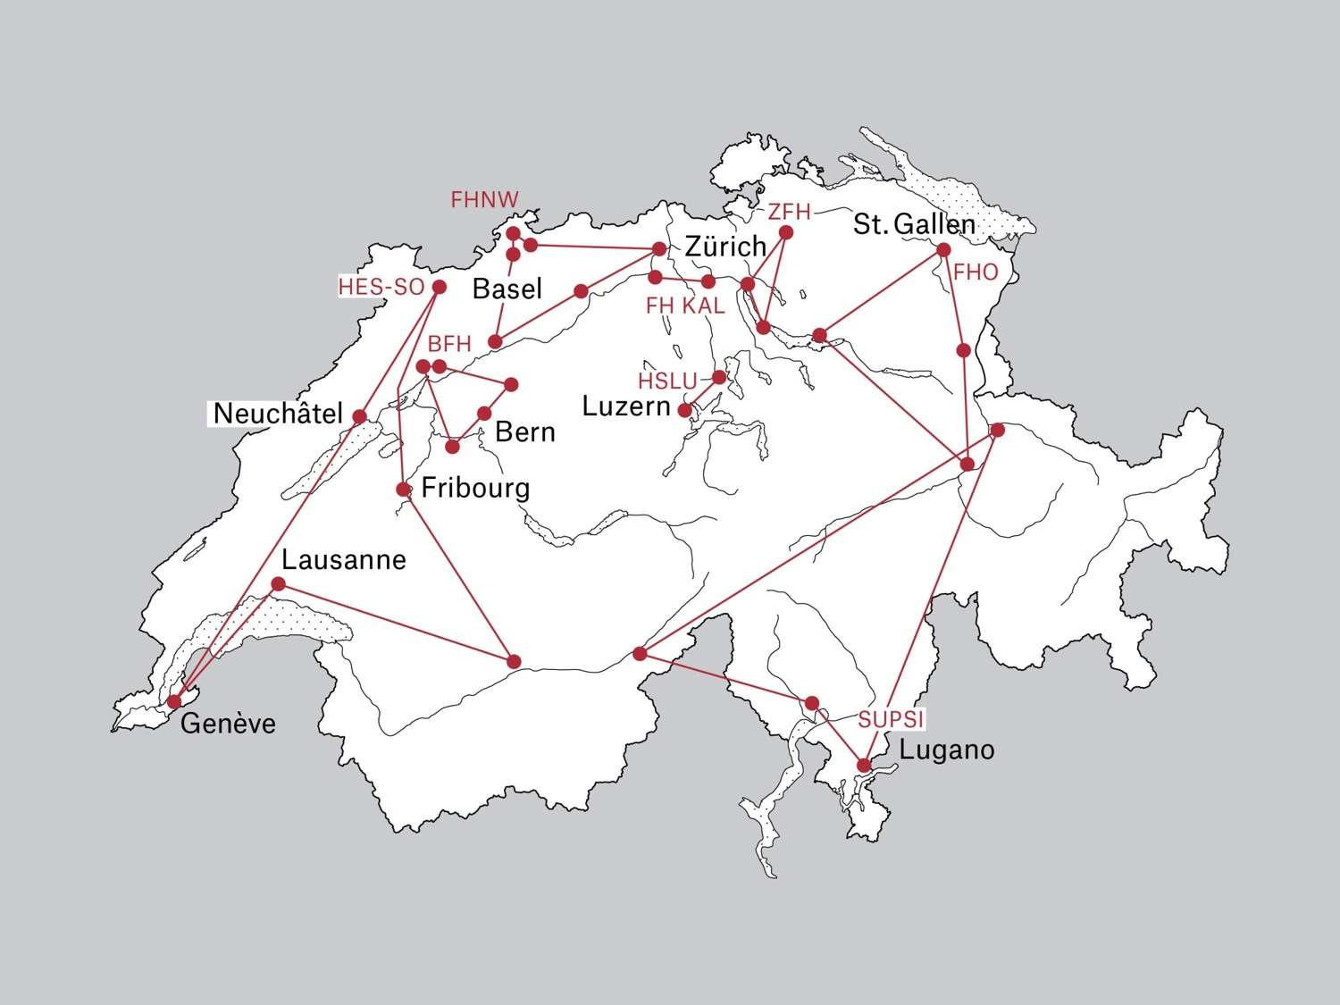
Swiss UAS landscape

Slide 32
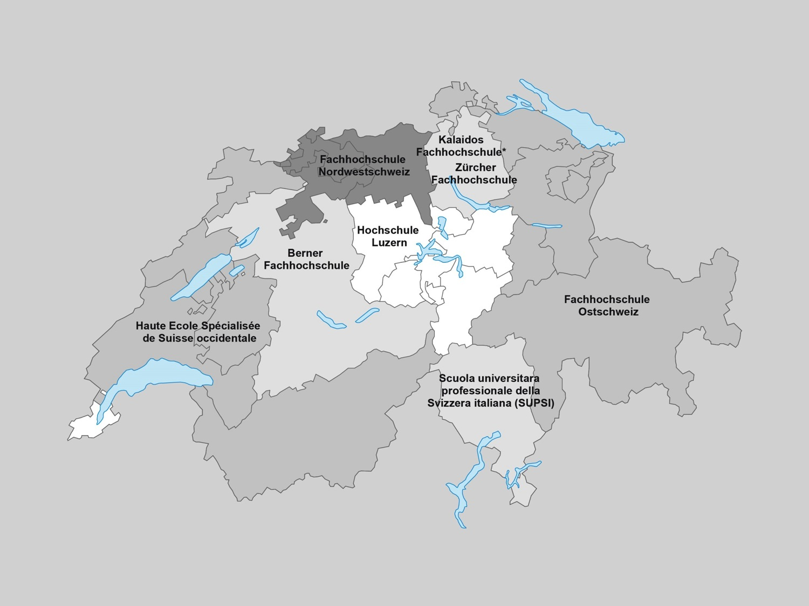
Swiss UAS landscape
Source: Federal Statistical Office, 2014
* Private University of Applied Sciences

Slide 33
The Swiss Universities
Of Applied Sciences and Arts …

Slide 34

1
… are highly relevant to practice.

Slide 35

2
… increase companies’ innovative strength.

Slide 36

3
… provide the employment market with the experts it needs.

Slide 37

4
… provide excellent job and career prospects for their graduates.

Slide 38

5
… comply with Swiss quality standards in the field of education and research.

Slide 39

6
… lay the foundation for sustainable economic, cultural and social progress.

Slide 40
Six areas of study –
the benefit of specialisation
Source: Federal Statistical Office, 2014

Slide 41

20%
Technology, IT, architecture,
civil engineering, planning

Slide 42

5%
Chemistry, life sciences,
agriculture

Slide 43

35%
Business, services,
applied linguistics

Slide 44

22%
Health care, social work,
applied psychology

Slide 45
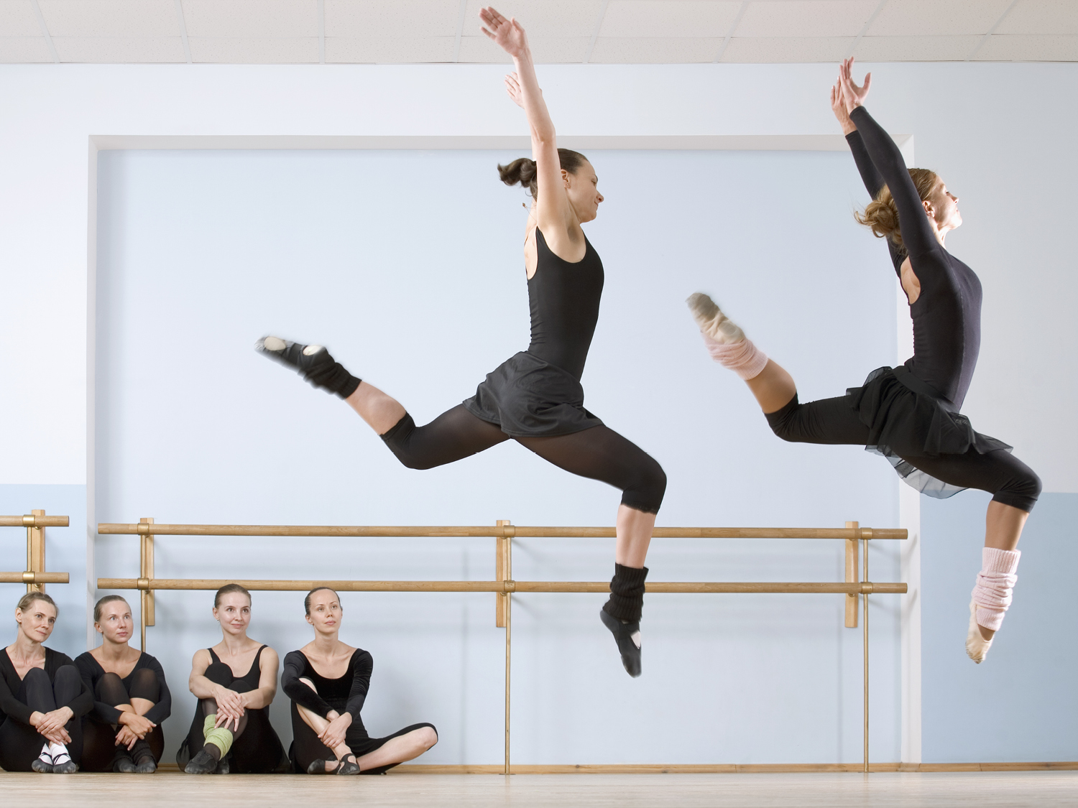
12%
Design, music, theatre,
fine art, dance

Slide 46

6%
Teacher education,
sport

Slide 47
4-fold mandate for the UAS
Education Theoretically sound & practice-oriented | Research Application-oriented & innovative
Continuing education Contemporary & in line with demand | Services Experience-based & tailor-made
Independent, action-oriented and creative people who shape the future
The foundation for lasting progress: Further development of economy, culture, and society through people and technology – taking into account social and economic needs and requirements

Slide 48

The degrees
Diplomas
Degree programmes: bachelor, master
Continuing education: CAS, DAS, EMBA
Degree courses
More than 230 BA degree programmes, ranging from architecture to business law
More than 100 MA degree programmes
Languages
Degree programmes in German, French, Italian as well as completely or partially
in English

Slide 49
Number of students by type of university
Development of student numbers at universities (U), universities of applied sciences and arts (UAS) and universities of teacher education (UTE)
142’164
143’961
131’417
112’375
68’802
70’180
60’930
43’721
18’489
19’476
10’419
14’105
2005/06
2010/11
2013/14
2014/15
Source: Federal Statistical Office, 2014

Slide 50
A model of success: number of UAS - students continuous to grow
[in 1,000]
Estimation
Source: Federal Statistical Office, 2014

Slide 51
Students by fields of studies
Source: Federal Statistical Office, 2014

Slide 52
Financing of the Swiss UAS
$ 2’735 million (CHF 2’556 million)
Confederation
19%
Source: Federal Statistical Office, 2014

Slide 53
Characterization and Financing of R&D for the UAS
Research at the UAS stands out by:
Large variety of topics
Scientifically sound and empirically based solutions for practical applications
Research questions take problems from the practice into account
Focus on the needs of the practice partners
Resources
Source: Federal Statistical Office, 2014

Slide 54
Costs of the Swiss UAS
$ 3040 million (CHF 2841 million)
Confederation
19%
Source: Federal Statistical Office, 2014

Slide 55
Selection of key issues 2016
Profile-specific Research and Teaching (with appropriate financing)
Research is scientific and practicable
Securing funding is essential (Teaching and Research)
Promoting Research at UAS (e.g. lack of specific instruments)
Promotion of young scientists /3rd cycle UAS – profile
Strengthening the specific double competence UAS- profile
Policy position of the UAS: doctorates run in cooperation with the universities!
Ensuring the UAS-specific profile of young scientist in Teaching and Research
Permeability – Interfaces:
Promoting the interfaces between the different types of universities
Securing and backing up the reference to the working world
Interface between Higher vocational education and UAS

Slide 56








Thank you
www.bfh.ch
www.hslu.ch
www.fhnw.ch
www.kalaidos-fh.ch
www.fho.ch
www.supsi.ch
www.hes-so.ch
www.zfh.ch

