Slide 1
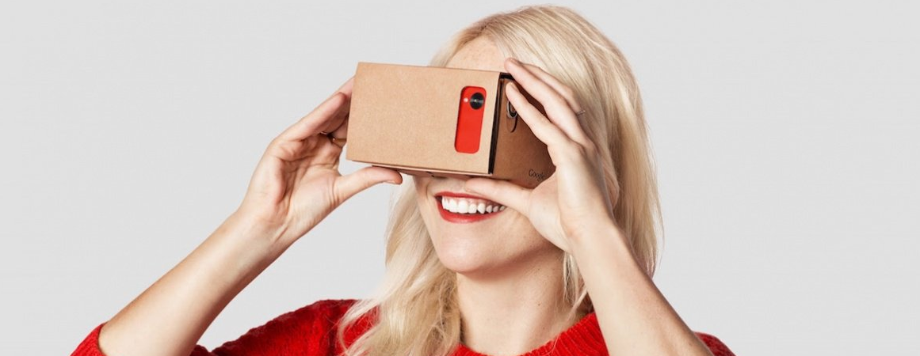


augmented learning for the digital campus
http://www.wareable.com/google/the-best-google-cardboard-apps
prof. dr. christian glahn @phish108 @htwblc
FHO Fachhochschule Ostschweiz

Slide 2

a LMS message from a student to a hard-line analog lecturer
(you find the topic selection in your mailbox)

Slide 3
most academic courses use some form of digital support
e-assessment
learning material
e-portfolios
classroom support
MOOCs
telepresence
flipped classroom
mobile learning
Notes:
First point

Slide 4
almost all of the 200’000 students in Switzerland work with educational technology regularly
e-assessment
learning material
e-portfolios
classroom support
MOOCs
telepresence
flipped classroom
mobile learning
Notes:
Second point

Slide 5
much of the technology we use in education today did not exist 10 years ago
Which Android phone would you have bought in 2007?
How did you show your Prezi in 2007?
What was learning analytics called in 2007?
How many MOOCs did you visit in 2007?
Which apps did you use on your iPad in 2007?

Slide 6
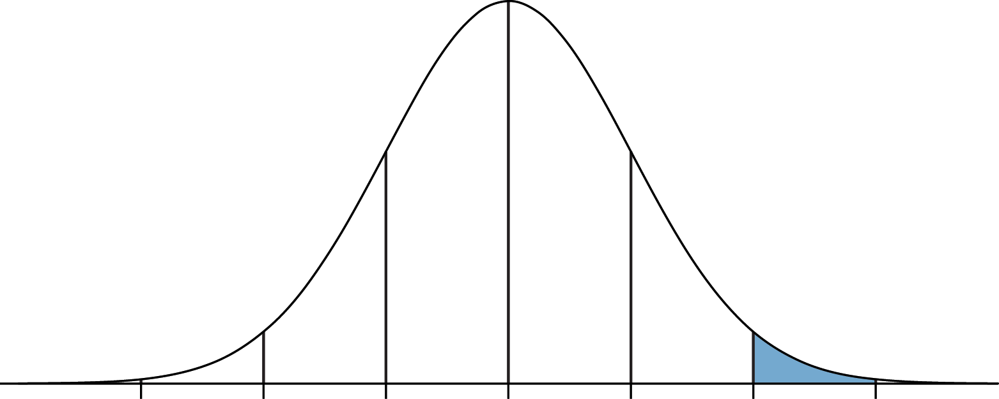
the innovation-adoption curve
Rogers, 2002
early majority
late adopters
early adopters
laggards
possibly dead
innovators
time

Slide 7
innovation is not about pampering the innovators

Slide 8
the innovation-adoption curve is broken
Moore, 2004
early majority
late adopters
early adopters
put your local initiative here
laggards
possibly dead
swiss virtual campus
AAA
AAA+
innovators

Slide 9
the digital campus needs a new take on digeetalization
Notes:
Thrid point

Slide 10
the e in digeetalization stand for everything and everybody

Slide 11
the t in digeetalization stand for transformative thinking

Slide 12
digeetalization is a scalability challenge
Sutton & Rao, 2014
early majority
late adopters
early adopters
laggards
possibly dead
innovators
upscaling

Slide 13
learning experiences in higher education
Inclass Activities
Kuh et al. 1994

Slide 14
blended learning
e-learning
Inclass Activities
Garrison & Vaughan, 2008
Notes:
Blended Learning is problematic, because thereare many different definitions and some do not include any aspects of digitalization.

Slide 15
augmented learning

Slide 16
augmented learning
Inclass Activities
technologies
quality
Notes:
Fourth point:
Augmented learning encompasses the imersion of digital technologies in all aspects of studying and teaching. The power of augmented learning lies in linking all facets of learning and studying into a holistic experience, just like our smart technologies link and augment allmost all aspects of our lifes.

Slide 17
evidence-based learning 2017 listen less measure more
Notes:
Fourth point

Slide 18
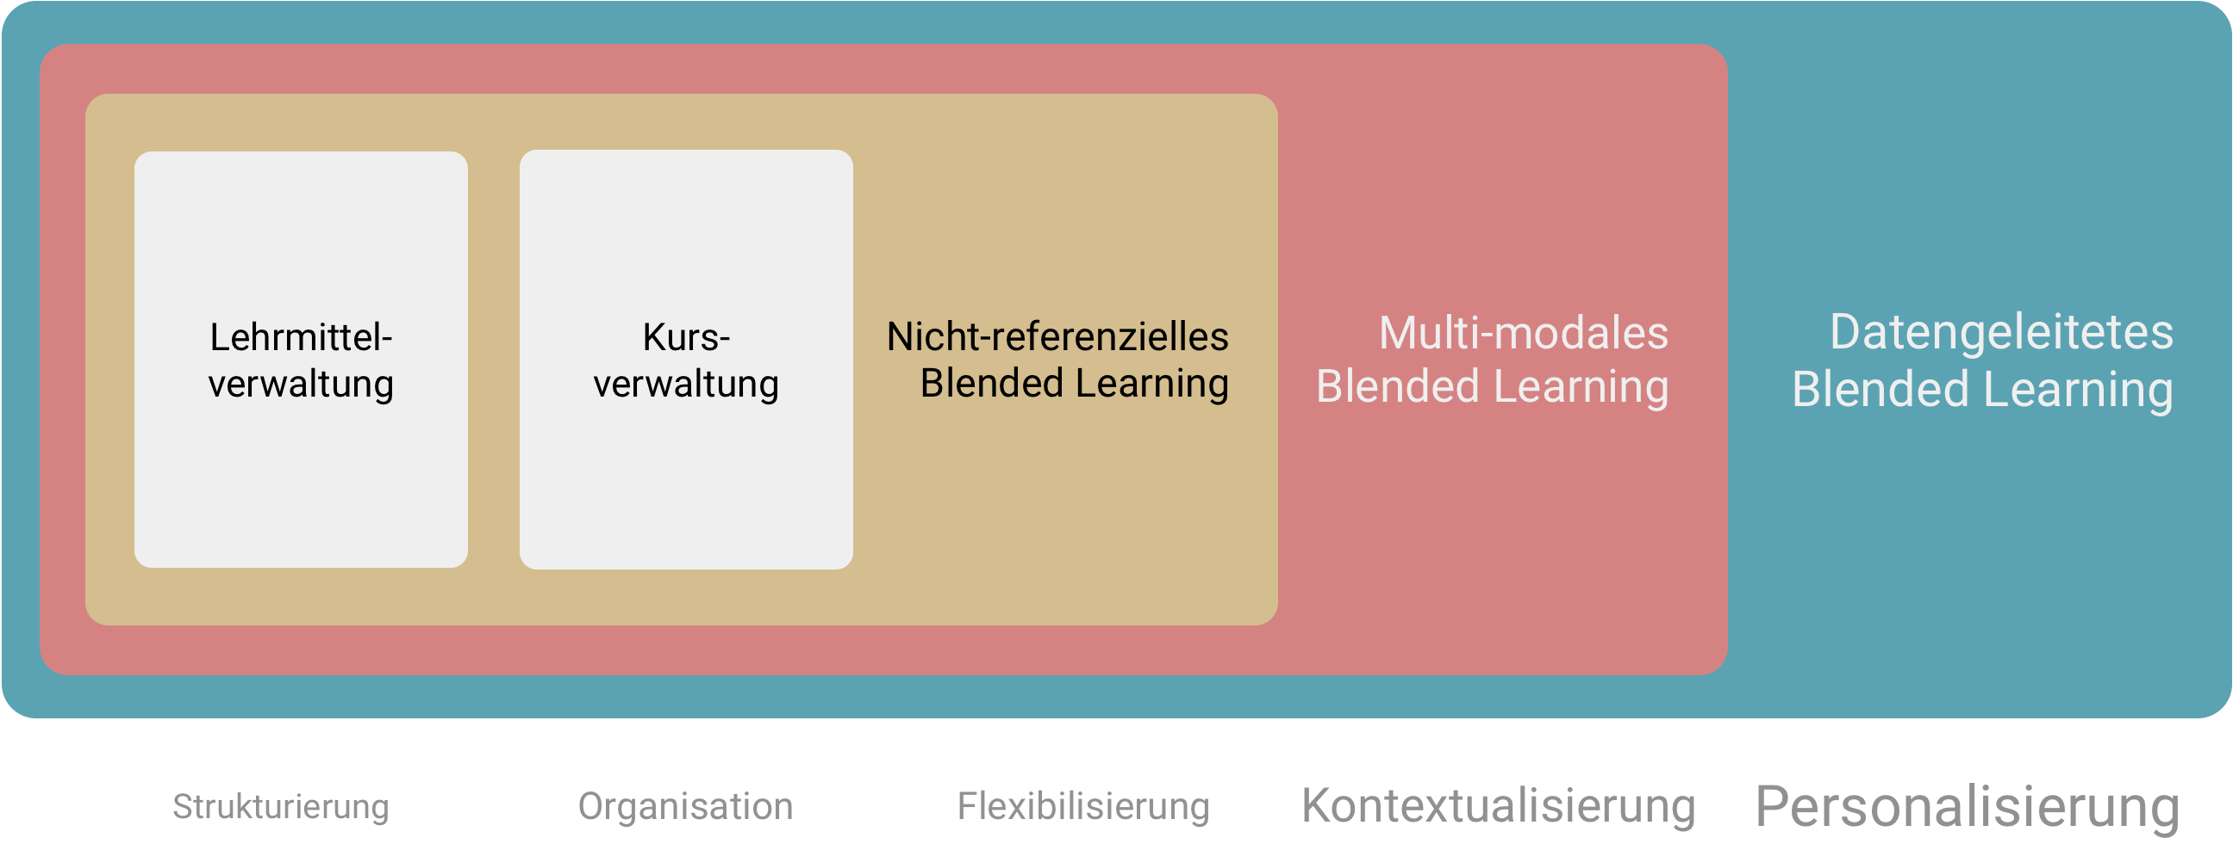
levels of augmentation
content
management
OER
course
management
non-referential
activities
multi-modal
activities
data-driven
augmentation
personalizing
socializing
structuring
organizing
flexibility
contextualizing

Slide 19
is everybody on board?
content
management
OER
course
management
non-referential
activities
multi-modal
activities
data-driven
augmentation
85%
3%
HTW in 2015

Slide 20
crossing the chasm
content
management
OER
course
management
non-referential
activities
multi-modal
activities
data-driven
augmentation
65%
23%
6%
2%
HTW in 2017

Slide 21
the pillars of augmented learning
methods & processes
tools & resources
reliable infrastructure
presence & support
Notes:
Fith point – safe environment for lecturers to embrace digeetalization

Slide 22
we could not do this without community
SIG E-Assessment
SAMOO
SIG Quality
SIG SwissMOOC
ETWG
SIG VIDEO
SIG Mobile Learning
eduhub
OpenOLAT
ILIASuisse
SIG OER
SEB Consortium
SIG e-portfolio

Slide 23
synergies across institutions
ETWG
eduhub
Notes:
Final point

