Slide 1
Higher Education Institutions at the Service of a Cantonal Learning Ecology for Sustainability Education (SE)
Nadia Lausselet (HEP-Vaud) et Thomas Jaccard (UNIL)

Slide 2
Overall goal of the project
Implement a whole school approach in schools and their partner institutions
*
Build an enabling learning ecology
*
«A number of interrelated and interdependent elements that combine to make up an organic system that allows those who are actively engaged in and with the system to learn in different ways»
Wals, 2019

Slide 3
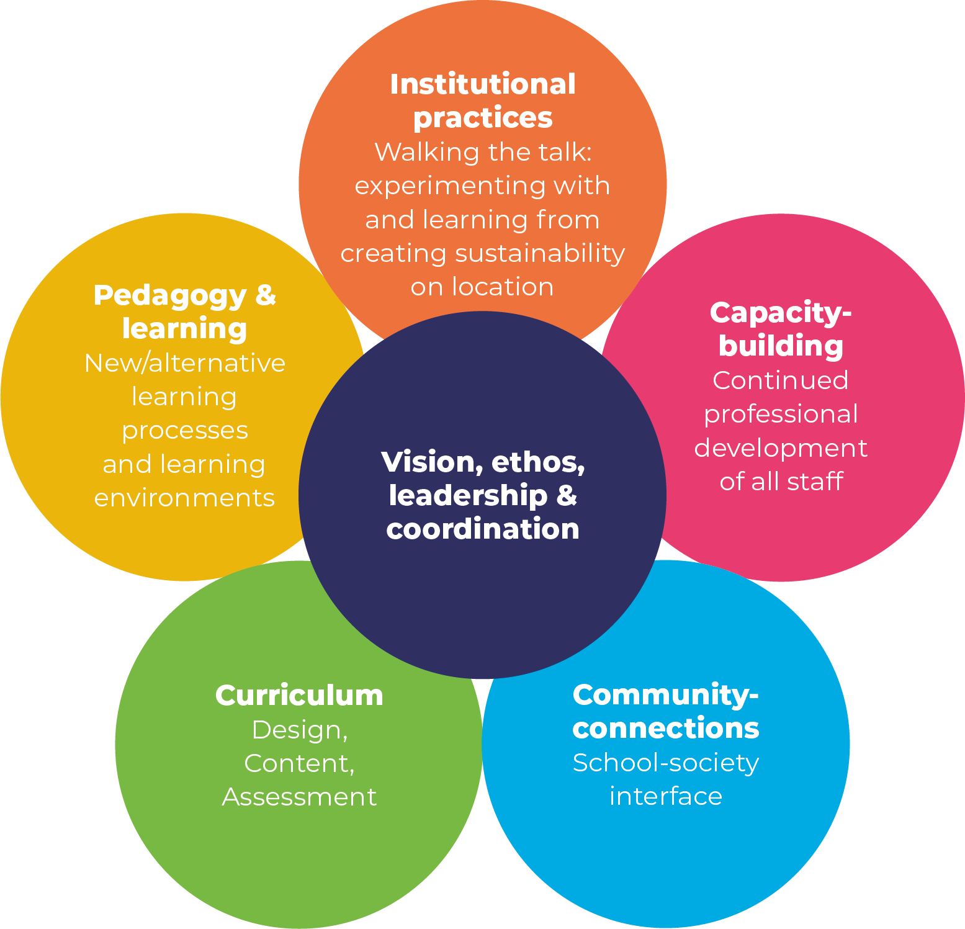
Whole school approach
Whole system approach
Wals 2022, adapted from Wals & Mathie, 2022

Slide 4
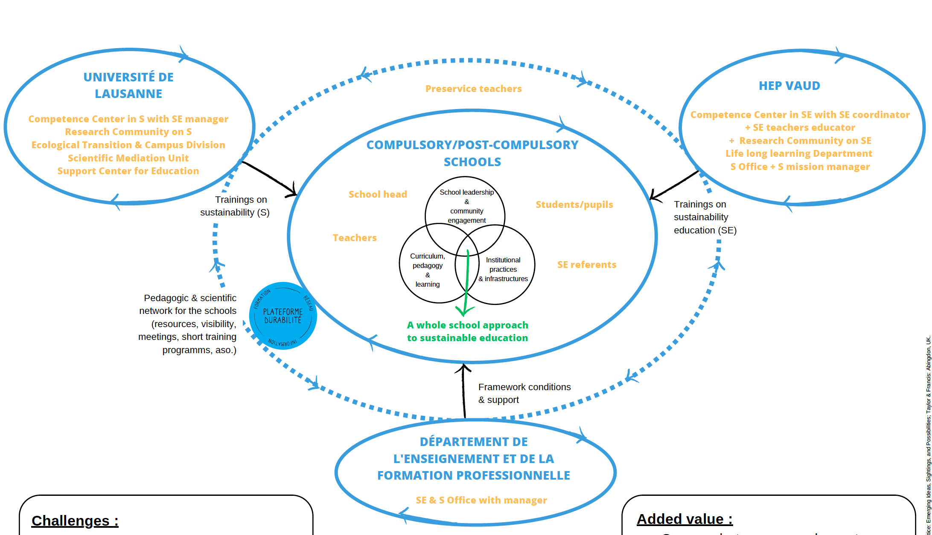
Learning ecology and roles
Sustainability related knowledge & pedagogy
⬄
Enabling governance

Slide 5
Issues
Added-value
Complementary areas of expertise
Stronger legitimacy
Alignment with local needs
Growth of the SE community
Challenges
Changing political context
Coordination
Risk of competition

Slide 6
Benefits
Third mission
Feedbacks on SE
Living lab
Access to the HEP research community on SE
Third mission
Broader scope in teaching SE
Internal legitimacy
Access to the UNIL research community on S
Foster SE and sustainability (whole school approach)
https://www.ecolevaudoisedurable.ch

Slide 7
Example
Needs
In-service teacher training on economy and sutstainability
Scientific expertise
Didactic expertise

Slide 8
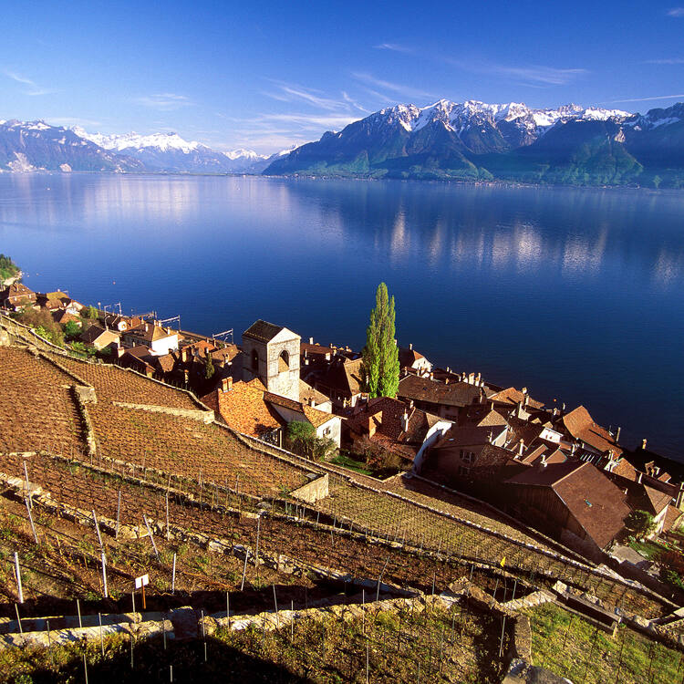
Thank you for your attention, and let’s discuss!
nadia.lausselet@hepl.ch
thomas.jaccard@unil.ch
https://whc.unesco.org/fr/list/1243/

